Slide 1

THE COMMERCIAL VEHICLE BOOKING
MUHSINA
MES24MCA-2035
Department of Computer Applications
MES College of Engineering, Kuttippuram
20-AUG-2025

Slide 2
PRODUCT OWNER Ms.FEBIN AZIZ Assistant Professor DEPARTMENT OF COMPUTER APPLICATIONS MES COLLEGE OF ENGINEERING, KUTTIPPURAM

Slide 3
TABLE OF CONTENTS
Introduction
Objective
Existing System
Proposed System
Motivation
Functionalities
Module Description
Developing Environment
Sprint Backlog
Product Backlog
User Story
Project Plans
Data Flow Diagrams
ER Diagram

Slide 4
THE COMMERCIAL VEHICLE BOOKING
Booking commercial vehicles is inefficient and lacks price transparency.
An online platform to simplify commercial vehicle booking.
The service will be accessible via a website and a mobile application for user convenience.

Slide 5
Key Features:
Browse and select vehicles.
Transparent pricing for easy comparison.
Real-time vehicle availability and scheduling.

Slide 6
OBJECTIVES
Easy Booking: Create a simple platform for booking commercial vehicles.
User-Friendly: Ensure easy navigation and access to vehicle info.
Wide Selection: Maintain a large database of commercial vehicles.
Admin Tools: Develop a dashboard for managing users, drivers, and vehicles.
Self-Service for Users/Drivers: Allow users and drivers to manage their own profiles and bookings.

Slide 7
EXISTING SYSTEM
Vehicle booking is mostly done manually through phone calls or local agents
Limited visibility of available vehicles leads to booking delays
No unified platform to compare vehicle types, prices, or schedules
Manual record-keeping causes errors and inefficiencies
Lack of transparency in pricing and availability

Slide 8
PROPOSED SYSTEM
Online Platform: Connects businesses and individuals with commercial vehicle operators.
Access: Available via a website or mobile application.
Key Features:Transparent pricing, Real-time availability and scheduling, Vehicle tracking.
Benefits: Offers convenience, time savings, and cost efficiency.

Slide 9
MOTIVATIONS
This project aims to create a centralized online platform to fix the inefficient and non-transparent traditional process of booking commercial vehicles.
Enhance the user experience with a user-friendly interface for easy navigation and quick access to information.
Provide transparent pricing , real-time availability , and vehicle tracking to offer convenience, save time, and promote cost efficiency.
A key motivation was to address difficulties in project planning and creating an attractive user interface.

Slide 10
FUNCTIONALITIES
User & Driver Management:
Login & Registration: Users and drivers can create accounts and log in.
Profile Management: Users and drivers can add and update their personal details and change passwords.
User/Driver Access: Users can view information about available drivers and vehicles.

Slide 11
FUNCTIONALITIES
Vehicle & Booking Management:
Vehicle Booking: Users can search, view, select, and book commercial vehicles based on various requirements (type, capacity, location, dates).
Vehicle Management (Drivers): Drivers can add and delete their registered vehicles.
Vehicle Filtering (Users): Users can filter vehicles by type for easier access.
Admin Dashboard: An administrative interface for managing:
Vehicle inventory (add, edit, delete).
User accounts and permissions.
Booking records.

Slide 12
MODULE DESCRIPTION
User Module: Manages user accounts and allows users to browse, book, and view commercial vehicles.
Driver Module: For vehicle operators to register, log in, add or delete vehicles, and manage their bookings and profile.
Admin Module: Provides a dashboard for administrators to manage users, drivers, vehicle inventory, and bookings.

Slide 13
DEVELOPING ENVIRONMENT
Framework: Django.
Front End: Templates from Colorlib and Bootstrapdash.
Back End: Python with the Django framework.
Database: A relational database is used to manage user, driver, vehicle, booking, and payment data.
Libraries:
Django Jazzmin:Improves the Django admin's look and navigation.
Pillow: Processes images, enabling resizing and cropping.
IDE:VS Code

Slide 14
SPRINT BACKLOG
Backlog tem | Status And Completion Date | Original Estimation in Hours | Day 1 hrs | Day 2 hrs | Day 3 hrs | Day 4 hrs | Day 5 hrs | Day 6 hrs | Day 7 hrs | Day 8 hrs | Day 9 hrs | Day 10 hrs
SPRINT1
Design user interface/registration | 11/8/25 | 1O | 0 | 2 | 2 | 2 | 0 | 1 | 1 | 1 | 1 | 0
Database setup | 22/8/25 | 14 | 1 | 1 | 1 | 2 | 2 | 2 | 2 | 2 | 0 | 1
Basic backend API | 24/8/25 | 10 | 1 | 1 | 1 | 0 | 0 | 0 | 0 | 0 | 0 | 0
Frontend setup | 25/8/25 | 8 | 1 | 1 | 1 | 1 | 1 | 1 | 1 | 1 | 0 | 0
SPRINT2
Vehicle data management | 28/8/25 | 14 | 1 | 1 | 1 | 2 | 2 | 2 | 2 | 1 | 1 | 1
Vehicle Search functinality | 30/8/25 | 13 | 1 | 1 | 2 | 1 | 2 | 2 | 1 | 1 | 1 | 1

Slide 15
SPRINT BACKLOG
Backlog tem | Status And Completion Date | Original Estimation in Hours | Day 1 hrs | Day 2 hrs | Day 3 hrs | Day 4 hrs | Day 5 hrs | Day 6 hrs | Day 7 hrs | Day 8 hrs | Day 9 hrs | Day 10 hrs
Vehicle details page | 5/9/25 | 8 | 2 | 2 | 1 | 1 | 2 | 0 | 0 | 0 | 0 | 0
Vehicle API development | 13/9/25 | 13 | 1 | 1 | 2 | 2 | 2 | 2 | 1 | 1 | 1 | 0
SPRINT3
Booking form implementation | 16/9/25 | 7 | 1 | 1 | 1 | 1 | 1 | 1 | 1 | 0 | 0 | 0
Booking api development | 18/9/25 | 7 | 0 | 2 | 1 | 1 | 1 | 1 | 1 | 0 | 0 | 0
Booking confirmation | 21/9/25 | 7 | 1 | 1 | 1 | 1 | 1 | 1 | 1 | 0 | 0 | 0

Slide 16
SPRINT BACKLOG
Backlog tem | Status And Completion Date | Original Estimation in Hours | Day 1 hrs | Day 2 hrs | Day 3 hrs | Day 4 hrs | Day 5 hrs | Day 6 hrs | Day 7 hrs | Day 8 hrs | Day 9 hrs | Day 10 hrs
SPRINT4
Admin dashboorad | 28/09/25 | 14 | 2 | 1 | 2 | 1 | 2 | 1 | 2 | 1 | 1 | 1
User &Booking Management(admin) | 2/10/25 | 14 | 2 | 2 | 2 | 2 | 2 | 1 | 1 | 1 | 1 | 1
Responsive Design & UX Review | 6/10/25 | 10 | 1 | 2 | 1 | 1 | 2 | 0 | 0 | 1 | 1 | 1
TOTAL |  | 149

Slide 17
PRODUCT BACKLOG
ID | NAME | PRIORITY <high/medium/low> | ESTIMATE (Hours) | STATUS <Planned/In progress/Completed>
1 | User Authentication & Profiles | High | 23 | planned
2 | Core Database Infrastructure | High | 13 | plannec
3 | Basic Backend Services | High | 20 | planned
4 | Initial Frontend Setup | MEDIUM | 10 | planned
5 | Admin Vehicle Management (CRUD) | HIGH | 10 | planned

Slide 18
PRODUCT BACKLOG
ID | NAME | PRIORITY <high/medium/low> | ESTIMATE (Hours) | STATUS <Planned/In progress/Completed>
6 | Vehicle Search Functionality | High | 23 | planned
7 | Detailed vehicle information | High | 13 | plannec
8 | Vehicle data APIs | High | 20 | planned
9 | Search & Listing Testing | MEDIUM | 10 | planned
10 | Vehicle Booking Process | HIGH | 20 | planned

Slide 19
PRODUCT BACKLOG
ID | NAME | PRIORITY <high/medium/low> | ESTIMATE (Hours) | STATUS <Planned/In progress/Completed>
11 | Booking Management APIs | High | 23 | planned
12 | Booking Confirmation &history | High | 13 | plannec
13 | Admin Dashboard | MEDIUM | 20 | planned
14 | Admin User & Booking Control | HIGH | 10 | planned
15 | Responsive Design & UX Review | MEDIUM | 10 | planned

Slide 20
USER STORY
User Story ID | As a type of User | I want to <Perform some task> | So that i can <Achieve Some Goal>
1 | USER | Register | Acess the booking system and personalize my experience
2 | USER | Login | securely access my profile and booking history
3 | USER | View Profile | View users profile in application
4 | ADMIN | manage user accounts (CRUD) | control system access and assist users with their profiles
5 | ADMIN | manage vehicle inventory (CRUD) | (CRUD)add, update, and remove vehicles available for booking
6 | ADMIN | Manage booking records | Oversees all booking and assist with modifications
7 | USER | View Profile | View users profile in application

Slide 21
USER STORY
User Story ID | As a type of User | I want to <Perform some task> | So that i can <Achieve Some Goal>
8 | USER | search for available commercial vehicles | find a suitable vehicle for my transport needs
9 | USER | view detailed information about a vehicle | make an informed decision before booking
10 | USER | book a commercial vehicle | reserve a specific vehicle for a defined period
11 | ADMIN | view an administrative dashboard | get an overview of system activity, bookings, and users
12 | ADMIN | send system-wide notifications | inform users about important updates or announcements

Slide 22
PROJECT PLAN
User StoryID | Task Name | Start Date | End Date | Days | Status
1 | Sprint 1 | 11/09/2025 | 17/09/2025 | 13 | planned
2 |  | 18/09/2025 | 19/09/2025 |  | planned
4 |  | 20/09/2025 | 22/09/2025 |  | planned
3 |  | 23/09/2025 | 24/09/2025 |  | planned
1,2 |  | 25/09/2025 | 27/09/2025 |  | planned
5 | Sprint 2 | 13/09/2025 | 23/09/2025 | 14 | planned
7 |  | 23/09/2025 | 24/09/2025 |  | planned
8,9 |  | 24/09/2025 | 29/09/2025 |  | planned
.

Slide 23
PROJECT PLAN
User StoryID | Task Name | Start Date | End Date | Days | Status
10 | SPRINT 3 | 27/8/2025 | 28/8/2025 | 15 | planned
11 |  | 28/8/2025 | 29/8/2025 |  | planned
12,13 |  | 29/10/2025 | 30/10/2025 |  | planned
15 | SPRINT 4 | 28/09/2025 | 1/10/2025 | 14 | planned
4,6 |  | 2/10/2025 | 5/10/2025 |  | planned
14,16 |  | 6/10/2025 | 10/10/2025 |  | planned

Slide 24
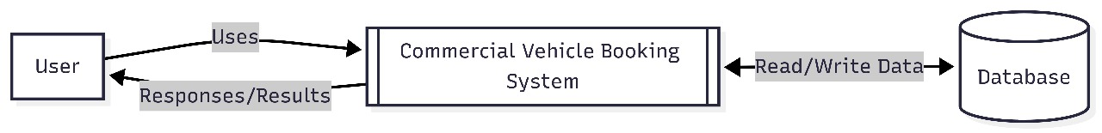
DATA FLOW DIAGRAM
LEVEL 0
The figure given above is for reference only. Create a figure with your data.

Slide 25
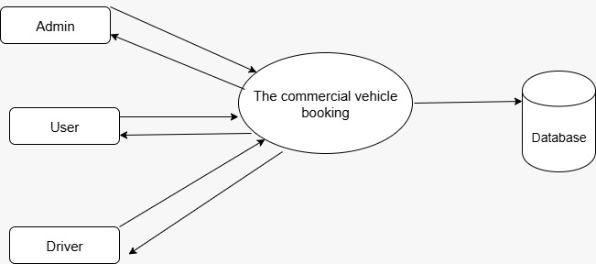
DATA FLOW DIAGRAM
Level 1

Slide 26
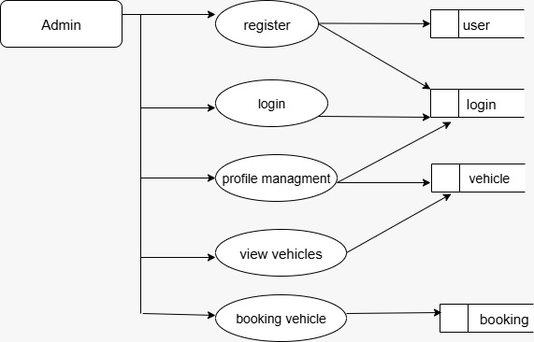
DATA FLOW DIAGRAM
Level 1.1

Slide 27
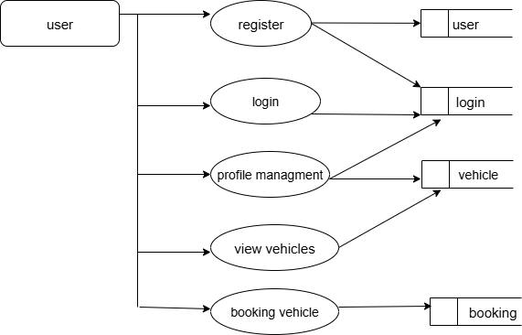
DATA FLOW DIAGRAM
Level 1.2

Slide 28
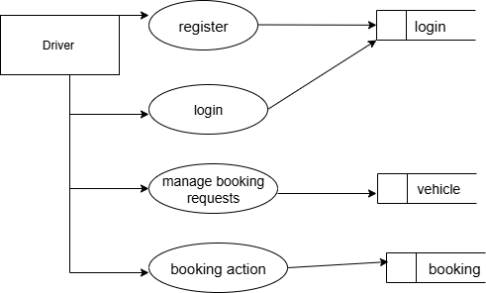
DATA FLOW DIAGRAM
Level 1.3

Slide 29
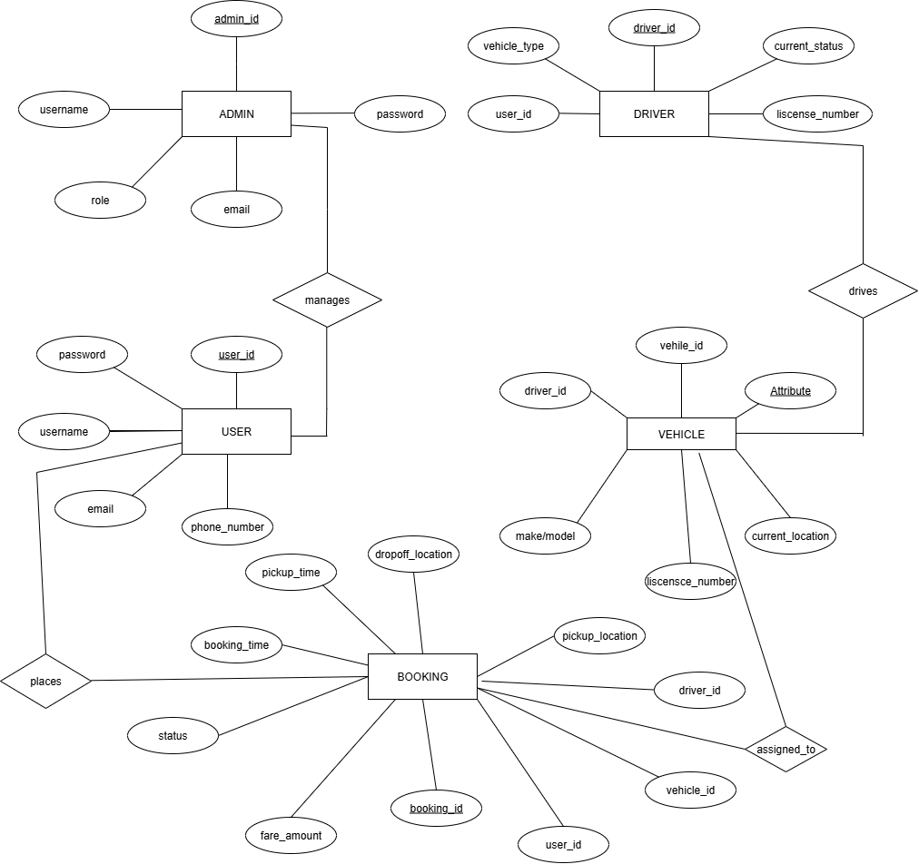
ER DIAGRAM

Slide 30
THANK YOU

